Slide 1
Adult census income prediction
Detail project report
Project by:
Panuganti Arun Kumar

Slide 2
Objective:
The main objective is to predict the income category of the census data based on different factors available in the provided dataset.
Benefit:
Prediction of flight fare
Useful in real world

Slide 3
Data Sharing Agreement:
Sample file name (Data_Train.csv)
No. of columns 13
No. of rows 10684
Column names: age, workclass, fnlwgt, education, education_num, marital_status, occupation, relationship, race, sex, capital_gain, capital_loss, hours_per_week, country, salary

Slide 4
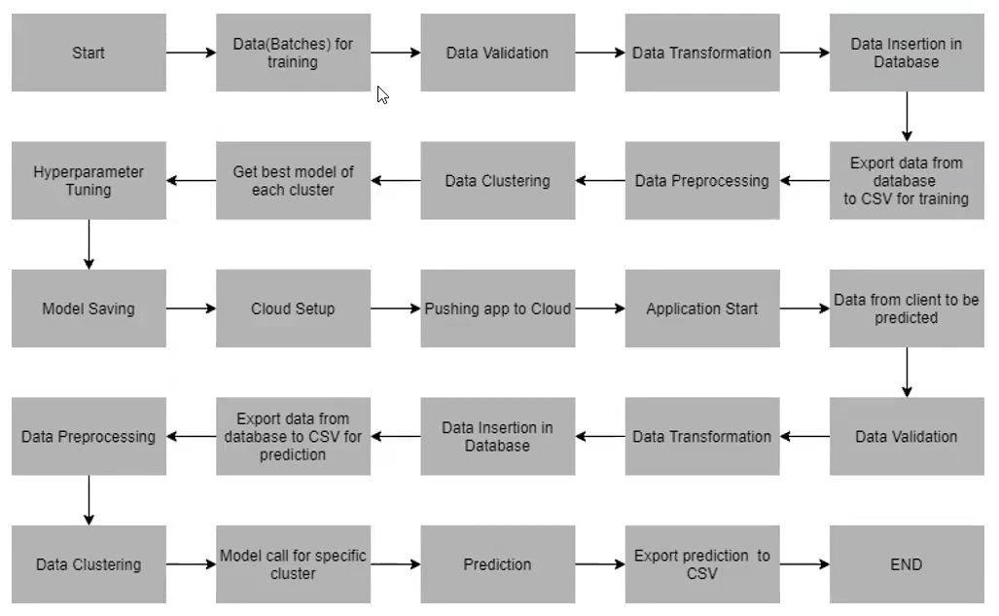
Architecture

Slide 5
Data Insertion into the Machine learning pipeline:
This stage is the first stage of Machine learning pipeline. Here the main task is to fetch the data which is in the remote file storage system.
These are the following tasks it perform:
Downloading the compressed file
Extracting it
Splitting the data into train and test using stratify sampling method
Saving in the Data ingestion artifact folderl

Slide 6
Data Validation and Data Transformation:
Column list of the dataset is given to Data validation stage in that phase the code will try to compare the columns of the dataset with the column list given to it.
It the columns doesn’t match it will generate log and raise the excpetion.
In Data Transformation the list of categorical and numerical column list is given to it. In this phase it tries to do dataset pre-processing using the custom pipeline.
It does tasks like imputing the missing data with the median for numeric and most frequent for categorical columns, one hot encoding and standardscaling.

Slide 7
Model training:
Data loading from artifact:
The transformed data is stored in the artifact folder we will fetch that data in model training
Hyperparameter tuning:
Here the model will be trained using various machine learning regression models by doing the hyperparameter tuning using GridSearchCV library and save the model to artifact folder

Slide 8
Model evaluation and selection:
In this stage the model selection is done. First this stage evaluate the best model using GridSearchCV and selects the best model. The basic idea is, this model will check the best model file path in the ‘saved models’ folder if that folder is empty it will save the current best model. Otherwise it will compare the accuracy of last model with the current model and accepts the best accuracy model. In this project we selected the base accuracy to be 60% and the difference between the train and test accuracy to be 0.05%.

Slide 9
Prediction:
This project uses flask web application for making it user friendly.
The facilities provided by the flask for this project is:
Train the model from webpage
View logs, artifacts, experiment history, update the config file, prediction based on user input.

Slide 10
QNA:
What is the source of data?
The data is used from Kaggle.
What was the type of data?
The dataset is the combination of numerical and categorical columns.
What’s the complete flow of you followed in this Project?
Refer slide 4 for better understanding.
After the File validation what you do with incompatible file or files which didn’t pass the validation?
Files like these are moved to the Achieve Folder and a list of these files has been shared with the client and we removed the bad data folder.

Slide 11
How logs are managed?
We are using different logs as per the steps that we follow in validation and modelling like File validation log , Data Insertion ,Model Training log , prediction log etc.
What techniques were you using for data pre-processing?
Removing unwanted attributes
Visualizing relation of independent variables with each other and output variables
Checking and changing distribution of continuous values
Removing outliers
Cleaning data and imputing if null values are present
Converting categorical data into numeric values
Scaling the data

Slide 12
How training was done or what models were used?
The dataset is split in 80:20 ratio by with the help of stratified sampling technique which ensure the equal distribution of statistics between train and test data. Which helps model to train with good accuracy.
The standard scaling was performed over training and testing data.
Algorithms like linear regression and Random forest were used with hyper parameter tuning. We provided user the facility to train the model with algorithms of their like. The parameters can be passed using json format.
How prediction was done?
With the help of flask web application we did the prediction

Slide 13
What are the different stages of deployment?
When the model is ready we push the code to github.
From the github action we push the project to the deployment server along with docker container.
Here we used HEROKU platform for deployment.

